Slide 1



Noida Institute of Engineering and Technology, Greater Noida
Microprocessor
(ACSE0405)
Unit: 2
8085 Instructions And Programming Techniques
KANIKA
Assistant Professor
Department of ECE
B Tech: 4th Sem.

Slide 2

Brief Introduction
Ms. KANIKA
M.Tech. Gateway institute of engineering and technology, sonipat , DCRUST
B.Tech B.M.I.E.T, MDU
Research Interests
Image processing
Academic Experience: (5 years)

Slide 3
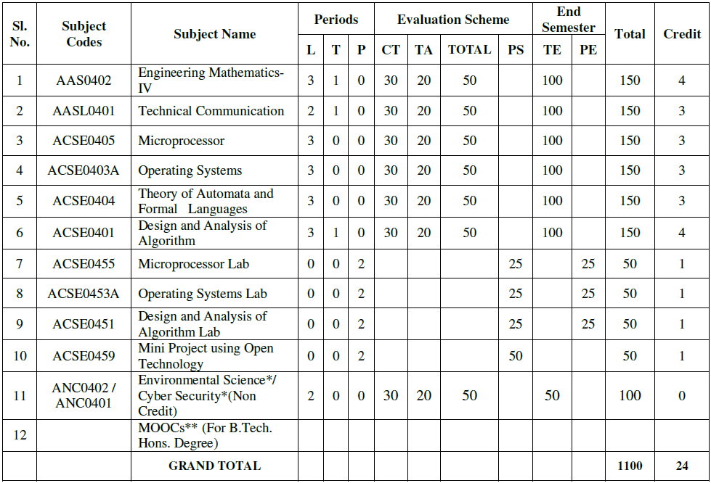
Evaluation Scheme

Slide 4
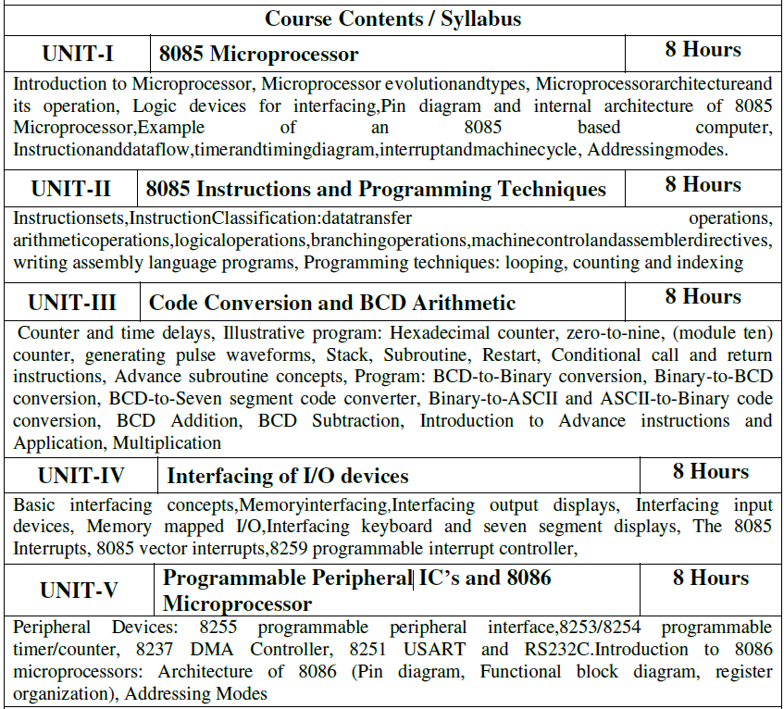
Subject Syllabus

Slide 5
Branch Wise Application
Microprocessor, any of a type of miniature electronic device that contains the arithmetic, logic, and control circuitry necessary to perform the functions of a digital computer’s central processing unit.
This kind of integrated circuit can interpret and execute program instructions as well as handle arithmetic operations.

Slide 6
Course Objective
The objective of this course is to understand basic concepts of Microprocessor based systems and able to do programming in Assembly Language of 8085. They will be able to learn and program Peripheral IC’s.

Slide 7
Course Outcome
At the end of this course students will able to:
Apply a basic concept of digital fundamentals to Microprocessor based personal computer system.
Analyze a detailed s/w & h/w structure of the Microprocessor.
Illustrate how the different peripherals (8085/8086) are interfaced with Microprocessor.
Analyze the properties of Microprocessors (8085/8086).
Evaluate the data transfer information through serial & parallel ports.

Slide 8
Program Outcomes
Program Outcomes are narrow statements that describe what the students are expected to know and would be able to do upon the graduation.
These relate to the skills, knowledge, and behavior that students acquire through the programmed.
Engineering knowledge
Problem analysis
Design/development of solutions
Conduct investigations of complex problems
Modern tool usage
The engineer and society
Environment and sustainability
Ethics
Individual and team work
Communication
Project management and finance
Life-long learning

Slide 9
CO-PO Mapping
Course Outcome | PO1 | PO2 | PO3 | PO4 | PO5 | PO6 | PO7 | PO8 | PO9 | PO10 | PO11 | PO12
ACSE0405.1 | 3 | 1 | 2 |  | 1 | - | - | - | - | - | - | 3
ACSE0405.2 | 3 | 1 | - |  | 1 | - | - | - | - | - | - | 2
ACSE0405.3 | 3 | 1 | 3 |  | 1 | - | - | - | - | - | - | 2
ACSE0405.4 | 3 | 1 | - |  | 1 | - | - | - | - | - | - | 2
ACSE0405.5 | 3 | 1 | 2 |  | 1 | - | - | - | - | - | - | 2
Average | 3 | 1 | 2.3 |  | 1 | - | - | - | - | - | - | 2.1

Slide 10
PSOs Mapping
Sr. No. | Course Outcome | PSO1 | PSO2 | PSO3
1 | ACSE0405.1 | 3 | 2 | 1
2 | ACSE0405.2 | 3 | 2 | 1
3 | ACSE0405.3 | 3 | 2 | 1
4 | ACSE0405.4 | 3 | 2 | 1
5 | ACSE0405.5 | 3 | 2 | 2
 | Average | 3 | 2 | 1.2

Slide 11
End Semester Question Paper Template
B.Tech (Semester IV Theory Examination 2021-22) Total Marks : 100
Note: Attempt all sections. If require any missing data, then choose suitably. Time: 3 hours
Section A
1. Attempt all questions in brief. 2 X 10 = 20
Q. No. | Question | Marks | CO
a. to j |  | 2
Section B
2. Attempt any three of the following 3 X 10 = 30
Q. No. | Question | Marks | CO
a to e |  | 10
Section C
Question no. 3,4,5,6,7. Attempt any one of the following 1 X 10 = 10
a |  | 10
b |  | 10

Slide 12
Prerequisites
Basic knowledge of 8085 microprocessor
Knowledge of its architecture and operations

Slide 13
Introduction to microprocessor
8085 is an 8-bit microprocessor as it operates on 8 bits at a time and is created with N-MOS technology. This microprocessor exhibits some unique characteristics and this is the reason it still holds popularity among the microprocessors.
Basically, 8085 was the first commercially successful microprocessor by Intel.

Slide 14
Unit Content
Course Objective
Unit Objective
Course Outcome
CO and PO Mapping
Topic Objective
Prerequisite
Instruction sets
Instructions classification
Data transfer operations
Arithmetic operations
Logical operations
Branching operations
Machine control and assembler directives
Writing assembly language programs
Programming techniques
Daily quiz & MCQs
Old Question Papers
Recap
Video Links
Weekly Assignments
References

Slide 15
Unit Objective
To understand the instructions sets of 8085 microprocessor
To learn writing assembly language programs
To discuss concept of classification of instructions
To acquire the knowledge of programming techniques

Slide 16
Instruction Set of 8085
Name of the Topic | Objective of the topic | Mapping with CO
Instruction Set of 8085 | To understand the instruction of 8085 microprocessor. | CO2

Slide 17
Prerequisite
Basic concept of Digital Logic.
Understanding of memory unit & data size.

Slide 18
Instruction Set of 8085
An instruction is a binary pattern designed inside a microprocessor to perform a specific function.
The entire group of instructions that a microprocessor supports is called Instruction Set.
8085 has 246 instructions.
Each instruction is represented by an 8-bit binary value.
These 8-bits of binary value is called Op-Code or Instruction Byte.

Slide 19
Instruction Set of 8085
Classification of Instruction Set
Data Transfer Instruction
Arithmetic Instructions
Logical Instructions
Branching Instructions
Control Instructions

Slide 20
Video Link
https://www.youtube.com/watch?v=ekkoIeonyzg

Slide 21
Daily Quiz
What is true about microprocessor?
A. Microprocessor is a controlling unit of a micro-computer
B. It is fabricated on a small chip capable of performing ALU (Arithmetic Logical Unit) operations
C. It also communicate with the other devices connected to it.
D. All of the above
Microprocessor consists of?
A. ALU
B. register array
C. control unit
D. All of the above

Slide 22
Daily Quiz
Which control instruction is followed by an un-conditional branch instructions so as to branch to a single location from the double ones with respect to specified status-bit condition?
jump instruction
branch instruction
skip instruction
return- from-subroutine instructions
Which category of microprocessor instructions detect the status conditions in registers and accordingly exhibit the variations in program sequence on the basis of detected results?
Transfer Instructions
Operation Instructions
Control Instructions
All of the above

Slide 23
Recap
Detail of various types of instruction set is discussed.

Slide 24
Data Transfer Operation
Name of the Topic | Objective of the topic | Mapping with CO
Data Transfer Operation | To learn different types of data transfer instructions. | CO2

Slide 25
Prerequisite
Basic concept of Digital Logic.
Overview of register set of 8085 microprocessor.

Slide 26
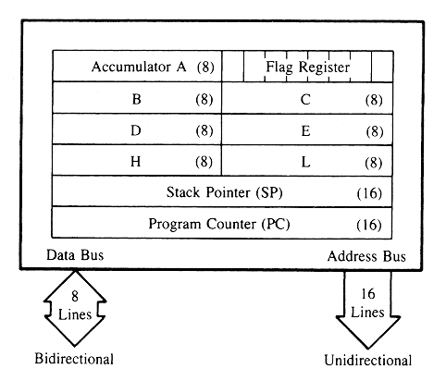
Data Transfer Operation
Data Transfer Instructions
These instructions move data between registers, or between memory and registers.
These instructions copy data from source to destination.
While copying, the contents of source are not modified.

Slide 27
Data Transfer Operation
Data Transfer Instructions
This instruction perform following six operation.
Load an 8 bit number in a register.
Load 16 bit number in a register pair.
Copy from register to register.
Copy between register & memory.
Copy between I/O & accumulator.
Copy between registers & stack memory.

Slide 28
Data Transfer Operation
Data Transfer Instructions
Opcode | Operand | Description
MOV | Rd, Rs M, Rs Rd, M | Copy from source to destination.
This instruction copies the contents of the source register into the destination register.
The contents of the source register are not altered.
If one of the operands is a memory location, its location is specified by the contents of the HL registers.
Example: MOV B, C or MOV B, M.

Slide 29
Data Transfer Operation
Data Transfer Instructions
Opcode | Operand | Description
MVI | Rd, Data M, Data | Move immediate 8-bit
The 8-bit data is stored in the destination register or memory.
If the operand is a memory location, its location is specified by the contents of the H-L registers.
Example: MVI B, 57H or MVI M, 57H

Slide 30
Data Transfer Operation
Data Transfer Instructions
Opcode | Operand | Description
LDA | 16-bit address | Load Accumulator
The contents of a memory location, specified by a 16-bit address in the operand, are copied to the accumulator.
The contents of the source are not altered.
Example: LDA 2034H

Slide 31
Data Transfer Operation
Data Transfer Instructions
Opcode | Operand | Description
LDAX | B/D Register Pair | Load accumulator indirect
The contents of the designated register pair point to a memory location. This instruction copies the contents of that memory location into the accumulator. The contents of either the register pair or the memory location are not altered.
Example: LDAX B
FFFFH
=C2
A | F
B | C
D | E
H | L
=2A
=50
2A50H
C2
0000H

Slide 32
Data Transfer Operation
Data Transfer Instructions
Opcode | Operand | Description
LXI | Reg. pair, 16-bit data | Load register pair immediate
This instruction loads 16-bit data in the register pair.
Example: LXI H, 2034 H

Slide 33
Data Transfer Operation
Data Transfer Instructions
Opcode | Operand | Description
LHLD | 16-bit address | Load H-L registers direct
This instruction copies the contents of memory location pointed out by 16-bit address into register L. It copies the contents of next memory location into register H.
Example: LHLD 2000 H
FFFFH
A | F
B | C
D | E
H | L
2002H
=2A
=50
2001H
2A
2000H
50
0000H

Slide 34
Data Transfer Operation
Data Transfer Instructions
Opcode | Operand | Description
STA | 16-bit address | Store accumulator direct
The contents of accumulator are copied into the memory location specified by the operand.
Example: STA 2050 H
FFFFH
=30
A | F
B | C
D | E
H | L
2050H
30
0000H

Slide 35
Data Transfer Operation
Data Transfer Instructions
Opcode | Operand | Description
STAX | Reg. pair | Store accumulator indirect
The contents of accumulator are copied into the memory location specified by the contents of the register pair.
Example: STAX B
FFFFH
=C2
A | F
B | C
D | E
H | L
=2A
=50
2A50H
C2
0000H

Slide 36
Data Transfer Operation
Data Transfer Instructions
Opcode | Operand | Description
SHLD | 16-bit address | Store H-L registers direct
The contents of register L are stored into memory location specified by the 16-bit address.
The contents of register H are stored into the next memory location.
Example: SHLD 2050 H
FFFFH
A | F
B | C
D | E
H | L
2052H
=8A
=45
2051H
8A
2050H
45
0000H

Slide 37
Data Transfer Operation
Data Transfer Instructions
Opcode | Operand | Description
XCHG | None | Exchange H-L with D-E
The contents of register H are exchanged with the contents of register D.
The contents of register L are exchanged with the contents of register E.
Example: XCHG
A | F
B | C
D | E
H | L
A | F
B | C
D | E
H | L
=20
=50
=75
=32
=75
=32
=20
=50

Slide 38
Data Transfer Operation
Data Transfer Instructions
Opcode | Operand | Description
SPHL | None | Copy H-L pair to the Stack Pointer (SP)
This instruction loads the contents of H-L pair into SP.
Example: SPHL

Slide 39
Data Transfer Operation
Data Transfer Instructions
Opcode | Operand | Description
XTHL | None | Exchange H–L with top of stack
The contents of L register are exchanged with the location pointed out by the contents of the SP.
The contents of H register are exchanged with the next location (SP + 1).
Example: XTHL

Slide 40
Data Transfer Operation
Data Transfer Instructions
Opcode | Operand | Description
PCHL | None | Load program counter with H-L contents
The contents of registers H and L are copied into the program counter (PC).
The contents of H are placed as the high-order byte and the contents of L as the low-order byte.
Example: PCHL

Slide 41
Data Transfer Operation
Data Transfer Instructions
Opcode | Operand | Description
PUSH | Reg. pair | Push register pair onto stack
The contents of register pair are copied onto stack.
SP is decremented and the contents of high-order registers (B, D, H, A) are copied into stack.
SP is again decremented and the contents of low-order registers (C, E, L, Flags) are copied into stack.
Example: PUSH D

Slide 42
Data Transfer Operation
Example : PUSH D
FFFFH
FFFFH
A | F
B | C
D | E
H | L
SP = 2000H
A | F
B | C
D | E
H | L
SP = 1FFEH
2001H
2001H
=10
=50
2000H
2000H
=10
=50
1FFFH
1FFFH
10
1FFEH
1FFEH
50
0000H
0000H
BEFORE PUSH D AFTER

Slide 43
Data Transfer Operation
Data Transfer Instructions
Opcode | Operand | Description
POP | Reg. pair | Pop stack to register pair
The contents of top of stack are copied into register pair.
The contents of location pointed out by SP are copied to the low-order register (C, E, L, Flags).
SP is incremented and the contents of location are copied to the high-order register (B, D, H, A).
Example: POP H

Slide 44
Data Transfer Operation
Example : POP D
FFFFH
FFFFH
A | F
B | C
D | E
H | L
SP = 2050H
A | F
B | C
D | E
H | L
SP = 2052H
2053H
2053H
2052H
2052H
=45
=30
2051H
45
2051H
45
2050H
30
30
2050H
0000H
0000H
BEFORE POP D AFTER

Slide 45
Data Transfer Operation
Data Transfer Instructions
Opcode | Operand | Description
OUT | 8-bit port address | Copy data from accumulator to a port with 8-bit address
The contents of accumulator are copied into the I/O port.
Example: OUT 78 H

Slide 46
Data Transfer Operation
Data Transfer Instructions
Opcode | Operand | Description
IN | 8-bit port address | Copy data to accumulator from a port with 8-bit address
The contents of I/O port are copied into accumulator.
Example: IN 8C H

Slide 47
Video Link
https://www.youtube.com/watch?v=ekkoIeonyzg

Slide 48
Daily Quiz
DAD is for Double ADD. DAD B instruction in 8085 is used for ?
a) Content of BC is added HL Result is in HL.
b) Content of BC is added to Accumulator
c) Content of BC is added to DE
DAA instruction is used for ____.
a) Double Add Accumulator.
b)Decimal Adjust Accumulator.
c)Decrement Accumulator
To save accumulator value and the flag register on to the stack, which of the following instructions is used?
a) PUSH PSW b) PUSH A c) PUSH SP d) POP PSW

Slide 49
Daily Quiz
What is the content of A at the end of this program?
MVI A, 06H
RLC
MOV B, A
RLC
RLC
ADD B
a) 3Ch b)18h c)0C h d)00 h
In 8085, HLT opcode means:
a) Remain idle for 10 seconds.\
b) Remain idle for 0.1 seconds
c) End of Program

Slide 50
Recap
Data transfer instructions of 8085 microprocessor is discussed.

Slide 51
Arithmetic operations
Name of the Topic | Objective of the topic | Mapping with CO
Arithmetic operations | To understand the arithmetic instructions of 8085 microprocessor. | CO2

Slide 52
Prerequisite
Basic concept of Digital Logic.
Knowledge of Boolean Algebra.
Register set of 8085 microprocessor.

Slide 53
Arithmetic operations
Arithmetic Instructions
Addition
Any 8-bit number, or the contents of register, or the contents of memory location can be added to the contents of accumulator.
The result (sum) is stored in the accumulator.
No two other 8-bit registers can be added directly.
Note: The contents of register B cannot be added directly to the contents of register C.

Slide 54
Arithmetic operations
Arithmetic Instructions
Subtraction
Any 8-bit number, or the contents of register, or the contents of memory location can be subtracted from the contents of accumulator.
The result is stored in the accumulator.
Subtraction is performed in 2’s complement form.
If the result is negative, it is stored in 2’s complement form.
No two other 8-bit registers can be subtracted directly.

Slide 55
Arithmetic operations
Arithmetic Instructions
Increment / Decrement
The 8-bit contents of a register or a memory location can be incremented or decremented by 1.
The 16-bit contents of a register pair can be incremented or decremented by 1.
Increment or decrement can be performed on any register or a memory location.

Slide 56
Arithmetic operations
Arithmetic Instructions
Opcode | Operand | Description
ADD | R M | Add register or memory to accumulator
The contents of register or memory are added to the contents of accumulator. The result is stored in accumulator.
If the operand is memory location, its address is specified by H-L pair.
All flags are modified to reflect the result of the addition.
Example: ADD B ( A+B A)
ADD M ( A+ M(HL) A)

Slide 57
Arithmetic operations
Arithmetic Instructions
Opcode | Operand | Description
ADC | R M | Add register or memory to accumulator with carry
The contents of register or memory and Carry Flag (CY) are added to the contents of accumulator. The result is stored in accumulator.
If the operand is memory location, its address is specified by H-L pair.
All flags are modified to reflect the result of the addition.
Example: ADC B ( A+B + CY A)
ADC M ( A+M(HL) + CY A)

Slide 58
Arithmetic operations
Arithmetic Instructions
Opcode | Operand | Description
ADI | 8-bit data | Add immediate to accumulator
The 8-bit data is added to the contents of accumulator.
The result is stored in accumulator.
All flags are modified to reflect the result of the addition.
Example: ADI 45 H ( A + 45 A)

Slide 59
Arithmetic operations
Arithmetic Instructions
Opcode | Operand | Description
ACI | 8-bit data | Add immediate to accumulator with carry
The 8-bit data and the Carry Flag (CY) are added to the contents of accumulator.
The result is stored in accumulator.
All flags are modified to reflect the result of the addition.
Example: ACI 45 H ( A + 45 + CY A)

Slide 60
Arithmetic operations
Arithmetic Instructions
Opcode | Operand | Description
DAD | Reg. pair | Add register pair to H-L pair
The 16-bit contents of the register pair are added to the contents of H-L pair.
The result is stored in H-L pair.
If the result is larger than 16 bits, then CY is set.
No other flags are changed.
Example: DAD B (HL + BC HL)

Slide 61
Arithmetic operations
Arithmetic Instructions
PROBLEM
DAD D
Let D=30H, E=20H
H= 1AH, L = 42 H
SOLUTION
H= 4AH & L = 62H

Slide 62
Arithmetic operations
Arithmetic Instructions
Opcode | Operand | Description
SUB | R M | Subtract register or memory from accumulator
The contents of the register or memory location are subtracted from the contents of the accumulator. The result is stored in accumulator.
If the operand is memory location, its address is specified by H-L pair.
All flags are modified to reflect the result of subtraction.
Example: SUB B (A – B A)
SUB M (A – M (HL) A)

Slide 63
Arithmetic operations
Arithmetic Instructions
Opcode | Operand | Description
SBB | R M | Subtract register or memory from accumulator with borrow
The contents of the register or memory location and Borrow Flag (i.e. CY) are subtracted from the contents of the accumulator. The result is stored in accumulator.
If the operand is memory location, its address is specified by H-L pair.
All flags are modified to reflect the result of subtraction.
Example: SBB B (A – B – CY A)
SBB M (A – M (HL) – CY A)

Slide 64
Arithmetic operations
Arithmetic Instructions
Opcode | Operand | Description
SUI | 8-bit data | Subtract immediate from accumulator
The 8-bit data is subtracted from the contents of the accumulator.
The result is stored in accumulator.
All flags are modified to reflect the result of subtraction.
Example: SUI 54 H (A – 54 A)

Slide 65
Arithmetic operations
Arithmetic Instructions
Opcode | Operand | Description
SBI | 8-bit data | Subtract immediate from accumulator with borrow
The 8-bit data and the Borrow Flag (i.e. CY) is subtracted from the contents of the accumulator.
The result is stored in accumulator.
All flags are modified to reflect the result of subtraction.
Example: SBI 45 H (A – 45 – CY A)

Slide 66
Arithmetic operations
Arithmetic Instructions
Opcode | Operand | Description
INR | R M | Increment register or memory by 1
The contents of register or memory location are incremented by 1. The result is stored in the same place.
If the operand is a memory location, its address is specified by the contents of H-L pair.
Example: INR B (B + 1 B)
INR M (M + 1 M)

Slide 67
Arithmetic operations
Arithmetic Instructions
Opcode | Operand | Description
INX | R | Increment register pair by 1
The contents of register pair are incremented by 1.
The result is stored in the same place.
Example: INX H (HL+1 HL)

Slide 68
Arithmetic operations
Arithmetic Instructions
Opcode | Operand | Description
DCR | R M | Decrement register or memory by 1
The contents of register or memory location are decremented by 1. The result is stored in the same place.
If the operand is a memory location, its address is specified by the contents of H-L pair.
Example: DCR B (B – 1 B)
DCR M (M – 1 M)

Slide 69
Arithmetic operations
Arithmetic Instructions
Opcode | Operand | Description
DCX | R | Decrement register pair by 1
The contents of register pair are decremented by 1.
The result is stored in the same place.
Example: DCX H (HL – 1 HL)

Slide 70
Arithmetic operations
Arithmetic Instructions
Opcode | Operand | Description
DAA |  | Decimal Adjust Accumulator (BCD format)
It converts hexadecimal to BCD no.
This instruction is used after addition instruction.
Operation:
If lower nibble is >9 or AC = 1 then add 06.
If higher nibble is >9 or CY = 1 then add 06.

Slide 71
Arithmetic operations
Arithmetic Instructions
DAA Instruction Example
1 ) A=34H & Data = 48H
2) A=37H & Data = 15H
3) A=85H & Data = 68H

Slide 72
Video Link
https://www.youtube.com/watch?v=ekkoIeonyzg

Slide 73
Daily Quiz
What is the content of PC Register at the end of the following program?
LXI H 8A79h
MOV A L
ADD H
DAA
MOV H A
PCHL
a) 2304 b) 6979 c) 7100 d) 8255
What does microprocessor speed depends on?
a) Clock
b) Data bus width
c) Address bus width
d) All of these

Slide 74
Daily Quiz
What is the status of z flag, cy flag, sign flag at the end of this program?
MVI A, 02H
MVI B, 03H
ADD B
XRA A
a) 1,0,0 b)0,1,0 c)1,0,0 d)1,0,1
What is the content of Register A at the end?
XRA A
MVI B, 4DH
SUI 4FH
ANA B
HLT
a) 00h b) 01h c) 4Dh

Slide 75
Weekly Assignment
Specify the contents of the A,B,C,D,E,H,L ,M registers as each if the following instructions is being executed.
MVI C,FFH
LXI H,2030H
LXI D,7050H
MOV M,C
XCHG
LDAX D
HLT
Specify the number of times the following loops are executed
LXI B,1000H
LOOP: DCX B
NOP
JNZ LOOP

Slide 76
Weekly Assignment
Specify the number of times the following loops are executed
MVI A,17H
LOOP: RAL
ORA A
JNC LOOP
Explain the meaning of the following program
LXI H,0000H
DAD SP
MOV A,H
OUT PORT1
MOV A,L
OUT PORT2

Slide 77
Recap
Arithmetic instructions of 8085 microprocessor with example is discussed.

Slide 78
Logic Operations
Name of the Topic | Objective of the topic | Mapping with CO
Logic Operations | To understand logic instructions of 8085 microprocessor. | CO2

Slide 79
Prerequisite
Basic concept of Digital Logic
Knowledge of Boolean Algebra
Register set of 8085 microprocessor.

Slide 80
Logic Operations
Logical Instructions
These instructions perform logical operations on data stored in registers, memory and status flags.
The logical operations are:
AND
OR
XOR
Rotate
Compare
Complement

Slide 81
Logic Operations
AND, OR, XOR
Any 8-bit data, or the contents of register, or memory location can logically have
AND operation
OR operation
XOR operation
with the contents of accumulator.
The result is stored in accumulator.

Slide 82
Logic Operations
Rotate
Each bit in the accumulator can be shifted either left or right to the next position.

Slide 83
Logic Operations
Compare
Any 8-bit data, or the contents of register, or memory location can be compares for:
Equality
Greater Than
Less Than
with the contents of accumulator.
The result is reflected in status flags.

Slide 84
Logic Operations
Complement
The contents of accumulator can be complemented.
Each 0 is replaced by 1 and each 1 is replaced by 0.

Slide 85
Logic Operations
Logical Instructions
Opcode | Operand | Description
ANA | R M | Logical AND register or memory with accumulator
The contents of the accumulator are logically ANDed with the contents of register or memory.
The result is placed in the accumulator.
If the operand is a memory location, its address is specified by the contents of H-L pair.
S, Z, P are modified to reflect the result of the operation.
CY is reset and AC is set.
Example: ANA B or ANA M.

Slide 86
Logic Operations
Logical Instructions
Opcode | Operand | Description
ANI | 8-bit data | Logical AND immediate with accumulator
The contents of the accumulator are logically ANDed with the 8-bit data.
The result is placed in the accumulator.
S, Z, P are modified to reflect the result.
CY is reset, AC is set.
Example: ANI 86H.

Slide 87
Logic Operations
Logical Instructions
Opcode | Operand | Description
ORA | R M | Logical OR register or memory with accumulator
The contents of the accumulator are logically ORed with the contents of the register or memory. The result is placed in the accumulator.
If the operand is a memory location, its address is specified by the contents of H-L pair.
S, Z, P are modified to reflect the result. CY and AC are reset.
Example: ORA E or ORA M.

Slide 88
Logic Operations
Logical Instructions
Opcode | Operand | Description
ORI | 8-bit data | Logical OR immediate with accumulator
The contents of the accumulator are logically ORed with the 8-bit data.
The result is placed in the accumulator.
S, Z, P are modified to reflect the result.
CY and AC are reset.
Example: ORI 20H.

Slide 89
Logic Operations
Logical Instructions
Opcode | Operand | Description
XRA | R M | Logical XOR register or memory with accumulator
The contents of the accumulator are XORed with the contents of the register or memory.
The result is placed in the accumulator.
If the operand is a memory location, its address is specified by the contents of H-L pair.
S, Z, P are modified to reflect the result of the operation.
CY and AC are reset.
Example: XRA D or XRA M.

Slide 90
Logic Operations
Logical Instructions
Opcode | Operand | Description
XRI | 8-bit data | XOR immediate with accumulator
The contents of the accumulator are XORed with the 8-bit data.
The result is placed in the accumulator.
S, Z, P are modified to reflect the result.
CY and AC are reset.
Example: XRI 23H.

Slide 91
Logic Operations
Logical Instructions
Opcode | Operand | Description
CMP | R M | Compare register or memory with accumulator
The contents of the operand (register or memory) are compared with the contents of the accumulator.
Both contents are preserved .
The result of the comparison is shown by setting the flags of the PSW as follows:

Slide 92
Logic Operations
Logical Instructions
if (A) < (reg/mem): carry flag is set
if (A) = (reg/mem): zero flag is set
if (A) > (reg/mem): carry and zero flags are reset.
Example: CMP C or CMP D or CMP M

Slide 93
Logic Operations
Logical Instructions
Opcode | Operand | Description
CPI | 8-bit data | Compare immediate with accumulator
The 8-bit data is compared with the contents of accumulator.
The values being compared remain unchanged.
The result of the comparison is shown by setting the flags of the PSW as follows:

Slide 94
Logic Operations
Logical Instructions
if (A) < data: carry flag is set
if (A) = data: zero flag is set
if (A) > data: carry and zero flags are reset
Example: CPI A6H

Slide 95
Logic Operations
Logical Instructions
Opcode | Operand | Description
RLC | None | Rotate accumulator left
Each binary bit of the accumulator is rotated left by one position.
Bit D7 is placed in the position of D0 as well as in the Carry flag.
CY is modified according to bit D7.
S, Z, P, AC are not affected.
Example: RLC

Slide 96
Logic Operations
Logical Instructions
Opcode | Operand | Description
RRC | None | Rotate accumulator right
Each binary bit of the accumulator is rotated right by one position.
Bit D0 is placed in the position of D7 as well as in the Carry flag.
CY is modified according to bit D0.
S, Z, P, AC are not affected.
Example: RRC

Slide 97
Logic Operations
Logical Instructions
Opcode | Operand | Description
RAL | None | Rotate accumulator left through carry
Each binary bit of the accumulator is rotated left by one position through the Carry flag.
Bit D7 is placed in the Carry flag, and the Carry flag is placed in the least significant position D0.
CY is modified according to bit D7.
S, Z, P, AC are not affected.
Example: RAL.

Slide 98
Logic Operations
Logical Instructions
Opcode | Operand | Description
RAR | None | Rotate accumulator right through carry
Each binary bit of the accumulator is rotated right by one position through the Carry flag.
Bit D0 is placed in the Carry flag, and the Carry flag is placed in the most significant position D7.
CY is modified according to bit D0.
S, Z, P, AC are not affected.
Example: RAR.

Slide 99
Logic Operations
Logical Instructions
Opcode | Operand | Description
CMA | None | Complement accumulator
The contents of the accumulator are complemented.
No flags are affected.
Example: CMA
A= ABH

Slide 100
Logic Operations
Logical Instructions
Opcode | Operand | Description
CMC | None | Complement carry
The Carry flag is complemented.
No other flags are affected.
Example: CMC

Slide 101
Logic Operations
Logical Instructions
Opcode | Operand | Description
STC | None | Set carry
The Carry flag is set to 1.
No other flags are affected.
Example: STC.

Slide 102
Video Link
https://www.youtube.com/watch?v=ekkoIeonyzg

Slide 103
Daily Quiz
The instruction that represents the ‘rotate source, count’ is
a) RCL
b) RCR
c) ROR
d) All of the mentioned
What is the function of STC instruction?
a) Store to C Register, the value of Accumulator
b) Set Carry to 1
c) Clear the Stack pointer.
After "XRA A" instruction is executed, what will be the status of Zero Flag?
a)1 b) 0 c) No change

Slide 104
Daily Quiz
What is the content of A-Register at the end of this program?
XRA A
MVI B, F0H
SUB B
a) 01H b) 0FH c)F0H d)10H
What is the content of A at the end of this program?
STC
MVI A, 35H
ACI 26H
a) 2Dh b) 5Ch c) 23h d) 5B h

Slide 105
Recap
Logical instructions of 8085 microprocessor with example is discussed.

Slide 106
Branch operation
Name of the Topic | Objective of the topic | Mapping with CO
Branch operation | To understand the branch & control instructions of 8085 microprocessor. | CO2

Slide 107
Prerequisite
Basic concept of Digital Logic
Knowledge of Boolean Algebra
Understanding of 8085 microprocessor architecture.

Slide 108
Branch operation
Branching Instructions
The branching instruction alter the normal sequential flow.
These instructions alter either unconditionally or conditionally.

Slide 109
Branch operation
Opcode | Operand | Description
CALL | 16-bit address | Call unconditionally
The program sequence is transferred to the memory location specified by the 16-bit address given in the operand.
Before the transfer, the address of the next instruction after CALL (the contents of the program counter) is pushed onto the stack.
Example: CALL 2034 H.

Slide 110
Branch operation
Example : CALL 6030H
FFFFH
FFFFH
A | F
B | C
D | E
H | L
SP = 3000H
PC= 2040H
A | F
B | C
D | E
H | L
SP = 2FFEH
PC= 6030H
3001H
3001H
3000H
3000H
2FFFH
2FFFH
20 = PCH
2FFEH
2FFEH
40=PCL
0000H
0000H
BEFORE CALL 6030H AFTER

Slide 111
Branch operation
Opcode | Operand | Description
Cx | 16-bit address | Call conditionally
The program sequence is transferred to the memory location specified by the 16-bit address given in the operand based on the specified flag of the PSW.
Before the transfer, the address of the next instruction after the call (the contents of the program counter) is pushed onto the stack.
Example: CZ 2034 H.

Slide 112
Branch operation
Call Conditionally
Opcode | Description | Status Flags
CC | Call on Carry | CY = 1
CNC | Call on Not Carry | CY = 0
CP | Call on Positive | S = 0
CM | Call on Minus | S = 1
CZ | Call on Zero | Z = 1
CNZ | Call on Not Zero | Z = 0
CPE | Call on Parity Even | P = 1
CPO | Call on Parity Odd | P = 0

Slide 113
Branch operation
Example : 2030H CZ 7050H
FFFFH
FFFFH
A=00 | F, Z=1
B | C
D | E
H | L
SP = 3000H
PC= 2030H
A=00 | F, Z=1
B | C
D | E
H | L
SP = 2FFEH
PC= 7050H
3001H
3001H
3000H
3000H
2FFFH
2FFFH
20 = PCH
2FFEH
2FFEH
30=PCL
0000H
0000H
BEFORE 2030H CZ 7050H AFTER

Slide 114
Branch operation
Opcode | Operand | Description
RET | None | Return unconditionally
The program sequence is transferred from the subroutine to the calling program.
The two bytes from the top of the stack are copied into the program counter, and program execution begins at the new address.
Example: RET.

Slide 115
Branch operation
Opcode | Operand | Description
Rx | None | Call conditionally
The program sequence is transferred from the subroutine to the calling program based on the specified flag of the PSW.
The two bytes from the top of the stack are copied into the program counter, and program execution begins at the new address.
Example: RZ.

Slide 116
Branch operation
Return Conditionally
Opcode | Description | Status Flags
RC | Return if Carry | CY = 1
RNC | Return if Not Carry | CY = 0
RP | Return if Positive | S = 0
RM | Return if Minus | S = 1
RZ | Return if Zero | Z = 1
RNZ | Return if Not Zero | Z = 0
RPE | Return if Parity Even | P = 1
RPO | Return if Parity Odd | P = 0

Slide 117
Branch operation
Branching Instructions
Opcode | Operand | Description
JMP | 16-bit address | Jump unconditionally
The program sequence is transferred to the memory location specified by the 16-bit address given in the operand.
Example: 2015H JMP 2008 H.
PC = 2015H
PC = 2008H
Before
After

Slide 118
Branch operation
Branching Instructions
Opcode | Operand | Description
Jx | 16-bit address | Jump conditionally
The program sequence is transferred to the memory location specified by the 16-bit address given in the operand based on the specified flag of the PSW.
Example: JZ 2034 H.

Slide 119
Branch operation
Jump Conditionally
Opcode | Description | Status Flags
JC | Jump if Carry | CY = 1
JNC | Jump if No Carry | CY = 0
JP | Jump if Positive | S = 0
JM | Jump if Minus | S = 1
JZ | Jump if Zero | Z = 1
JNZ | Jump if No Zero | Z = 0
JPE | Jump if Parity Even | P = 1
JPO | Jump if Parity Odd | P = 0

Slide 120
Branch operation
Opcode | Operand | Description
RST | 0 – 7 | Restart (Software Interrupts)
The RST instruction jumps the control to one of eight memory locations depending upon the number.
These are used as software instructions in a program to transfer program execution to one of the eight locations.
Example: RST 3.

Slide 121
Branch operation
Restart Address Table
Instructions | Restart Address
RST 0 | 0000 H
RST 1 | 0008 H
RST 2 | 0010 H
RST 3 | 0018 H
RST 4 | 0020 H
RST 5 | 0028 H
RST 6 | 0030 H
RST 7 | 0038 H

Slide 122
Control Operation
Control Instructions
The control instructions control the operation of microprocessor.
Opcode | Operand | Description
NOP | None | No operation
No operation is performed.
The instruction is fetched and decoded but no operation is executed.
Example: NOP

Slide 123
Control Operation
Opcode | Operand | Description
HLT | None | Halt
The CPU finishes executing the current instruction and halts any further execution.
An interrupt or reset is necessary to exit from the halt state.
Example: HLT

Slide 124
Control Operation
Opcode | Operand | Description
DI | None | Disable interrupt
The interrupt enable flip-flop is reset and all the interrupts except the TRAP are disabled.
No flags are affected.
Example: DI

Slide 125
Control Operation
Opcode | Operand | Description
EI | None | Enable interrupt
The interrupt enable flip-flop is set and all interrupts are enabled.
No flags are affected.
This instruction is necessary to re-enable the interrupts (except TRAP).
Example: EI

Slide 126
Control Operation
Opcode | Operand | Description
RIM | None | Read Interrupt Mask
This is a multipurpose instruction used to read the status of interrupts 7.5, 6.5, 5.5 and read serial data input bit.
The instruction loads eight bits in the accumulator with the following interpretations.
Example: RIM

Slide 127
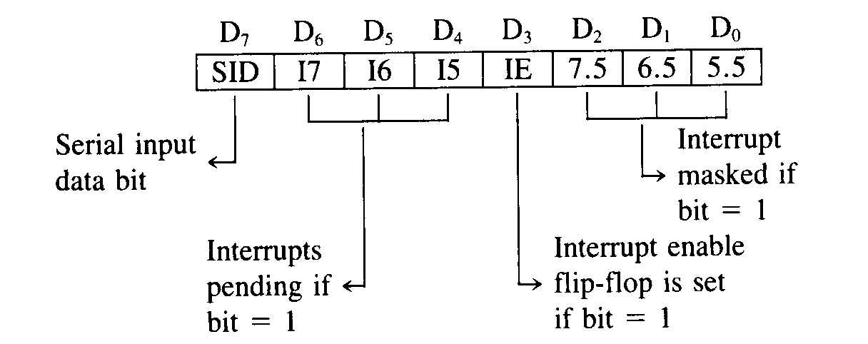
Control Operation
RIM Instruction

Slide 128
Control Operation
Opcode | Operand | Description
SIM | None | Set Interrupt Mask
This is a multipurpose instruction and used to implement the 8085 interrupts 7.5, 6.5, 5.5, and serial data output.
The instruction interprets the accumulator contents as follows.
Example: SIM

Slide 129
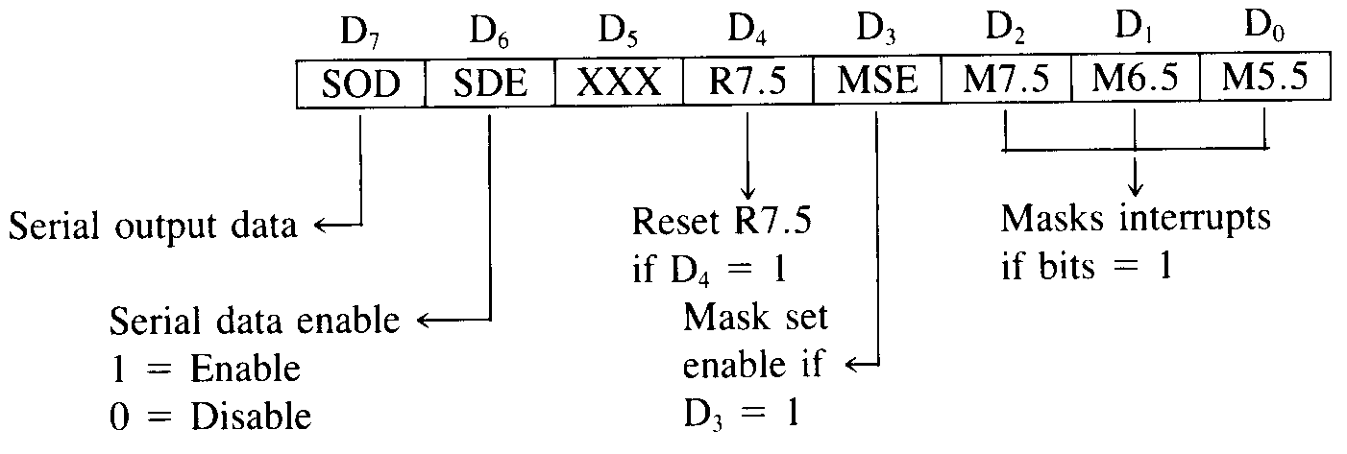
Control Operation
SIM Instruction

Slide 130
Video Link
https://www.youtube.com/watch?v=ekkoIeonyzg

Slide 131
Daily Quiz
What does the last instruction of each subroutine that transfer the control to the instruction in the calling program with temporary address storage , called as?
jump to subroutine
branch to subroutine
return from subroutine
call subroutine
What is SIM?
Select interrupt mask
Sorting interrupt mask
Set interrupt mask
None of these

Slide 132
Daily Quiz
Which instruction is used to set the interrupt by maintaining the serial output bit in set mode of operation?
SIM
STC
SBI Data
SUI Data
Which instruction indicates the transfer of program sequence to the address specified by 16 bit value if Z flag =0 ?
CZ Address
CNZ Address
CPE Address
CPO Address

Slide 133
Weekly Assignment
How many times NOP instruction will be executed in the following program;
MVI A, 10H
MVI B, 10H
BACK: NOP
ADD B
RLC
JNC BACK
HLT

Slide 134
Weekly Assignment
What is the output at 1236,1237 for the following program?
MVI C,00
MVI D,80H
MVI E,80H
MOV A,D
MOV B,A
MOV A,E
ADD B
JNC LOOP
INR C
LOOP: STA 1236
MOV A,C
STA 1237
HLT

Slide 135
Recap
Logical & control instructions of 8085 microprocessor are discussed.

Slide 136
Assembler Directives
Assembler Directives
Definition: Assembler directives are the instructions used by the assembler at the time of assembling a source program. More specifically, we can say, assembler directives are the commands or instructions that control the operation of the assembler.
Assembler directives are the instructions provided to the assembler, not the processor as the processor has nothing to do with these instructions. These instructions are also known as pseudo-instructions or pseudo-opcode.

Slide 137
Assembler Directives
Now the question arises what assembler directives specifically do?
So, assembler directives:
show the beginning and end of a program provided to the assembler,
used to provide storage locations to data,
used to give values to variables,
define the start and end of different segments, procedures or macros etc. of a program.
Content: Assembler Directives
What is an Assembler?
Assembler Directives of 8085

Slide 138
Assembler Directives
What is an Assembler?
We know that assembly language is a less complex and programmer-friendly language used to program the processors. In assembly language programming, the instructions are specified in the form of mnemonics rather in the form of machine code i.e., 0 and 1. But the microprocessor or microcontrollers are specifically designed in a way that they can only understand machine language.
Thus assembler is used to convert assembly language into machine code so that it can be understood and executed by the processor. Therefore, to control the generation of machine codes from the assembly language, assembler directives are used. However, machine codes are only generated for the program that must be provided to the processor and not for assembler directives because they do not belong to the actual program.

Slide 139
Assembler Directives
Assembler Directives of 8085
The assembler directives given below are used by 8085 and 8086 assemblers:
DB: Define Byte
This directive is used for the purpose of allocating and initializing single or multiple data bytes.
Memory name AREA has three consecutive locations where 30H, 52H and 35H are to be stored.
DW: Define Word
DW: Define Word
It is used for initialising single or multiple data words (16-bit).
These two 16-bit data 1020H and 4216H are stored at 4 consecutive locations in the memory MARK.
END: End of program
This directive is used at the time of program termination.
EQU: Equate
It is used to assign any numerical value or constant to the variable.
Variable name ‘DONE’ has value 10H

Slide 140
Assembler Directives
MACRO: Represents beginning
Shows the beginning of macro along with defining name and parameters.
ENDM: End of macro
ENDM indicates the termination of macro.
where macroname (STEP) is specified by the user.
ORG: Origin
This directive is used at the time of assigning starting address for a module or segment.
By this instruction, the assembler gets to know that the statements following this instruction, must be stored in the memory location beginning with address 1050H.

Slide 141
Video Link
https://www.youtube.com/watch?v=CPgFscob2T8

Slide 142
Daily Quiz
In an Intel 8085A, which is the first machine cycle of an instruction?
a. An op-code fetch cycle
b. A memory read cycle
c. A memory write cycle
d. An I/O read cycle
What are level Triggering interrupts?
a) INTR&TRAP
b)RST6.5&RST5.5
c)RST7.5&RST6.5
What is the RST for the TRAP?
a) RST5.5 b) RST4.5 c) RST4

Slide 143
Daily Quiz
Which interrupt is not level sensitive in 8085?
a) RST6.5 is a raising edge-trigging interrupt.
b) RST7.5 is a raising edge-trigging interrupt.
c) a & b.
RIM is used to check whether, ______
a) The write operation is done or not
b) The interrupt is Masked or not
c) a & b
What is meant by Maskable interrupts?
a) An interrupt which can never be turned off.
b) An interrupt that can be turned off by the programmer.
c) none

Slide 144
Recap
Problem related to T States & examples of assembly level languages are discussed.

Slide 145
Programming Techniques
Programming Techniques in Microprocessor 8085:
We have seen the instruction set of 8085 and some simple assembly language programs using it. We know that, the program is an implementation of certain logic by executing group of instructions. To implement program logic we need to take help of some common Programming Techniques in Microprocessor 8085 such as looping, counting, indexing and code conversion.
In this section, we are going to study how to implement these Programming Techniques in Microprocessor 8085 assembly language and some programming examples using them.
1. Looping, Counting and Indexing:
Before going to implement these Programming Techniques in Microprocessor 8085, we get conversant with these techniques and understand the use of them.

Slide 146
Programming Techniques
Looping : In this Programming Techniques in Microprocessor 8085, the Program is instructed to execute certain set of instructions repeatedly to execute a particular task number of times. For example, to add ten numbers stored in the consecutive memory locations we have to perform addition ten times.
Counting : This technique allows programmer to count how many times the instruction/set of instructions are executed.
Indexing : This Programming Techniques in Microprocessor 8085 allows programmer to point or refer the data stored in sequential memory locations one by one. Let us see the program loop to understand looping, counting and indexing.

Slide 147
Daily quiz
Which of the following is used as a primary storage device?
Magnetic drum
PROM
Floppy disk
All of these
Which of the following memories needs refresh?
SRAM
DRAM
ROM
All of above

Slide 148
Weekly Assignment
How many times NOP instruction will be executed in the following program;
MVI A, 10H
MVI B, 10H
BACK: NOP
ADD B
RLC
JNC BACK
HLT

Slide 149
Weekly Assignment
What is the output at 1236,1237 for the following program?
MVI C,00
MVI D,80H
MVI E,80H
MOV A,D
MOV B,A
MOV A,E
ADD B
JNC LOOP
INR C
LOOP: STA 1236
MOV A,C
STA 1237
HLT

Slide 150
Topic links
Youtube /other Video Links
https://www.youtube.com/watch?v=iJmcgQRk048
https://www.youtube.com/watch?v=ekkoIeonyzg
https://www.youtube.com/watch?v=79icCUmqyPc
https://www.youtube.com/watch?v=Bn0FhaaH6RA

Slide 151
MCQ s
Which of the following are the two main components of the CPU?
Control Unit and Registers
Registers and Main Memory
Control unit and ALU
ALU and bus
The language that the computer can understand and execute is called:
Machine language
Application software
System program
All of the above

Slide 152
MCQ s
Which of the following is used as a primary storage device?
Magnetic drum
PROM
Floppy disk
All of these
Which of the following memories needs refresh?
SRAM
DRAM
ROM
All of above

Slide 153
MCQ s
What is another name of memory stack especially given for the fundamental function performed by it?
Last-in-first-out (LIFO)
First-in-last-out (FILO)
First-in-first-out (FIFO)
Last-in-last-out (LILO)
Registers, which are partially visible to users and used to hold conditional, are known as
PC
Memory address registers
General purpose register
Flags

Slide 154
Glossary questions
(Machine language, Control unit and ALU, DRAM, PROM)
Choose the correct one from above :
What are the two main components of the CPU?
The language that the computer can understand and execute is called:
Which is used as a primary storage device?
Which memories needs refresh?

Slide 155
Old question papers
Write an ALP to multiply two eight bit numbers.
Write a program for transferring the contents of Memory location 2050 H to the register B and the contents of 2051 H to Register C. The contents of memory location 2050 H are 10 of 2051 H are 11.
Find the total time to execute the above program if the frequency of the processor is 5MHz.
MVI A,17H
LOOP: RAL
ORA A
JNC LOOP

Slide 156
Expected Questions for University Exam
Explain the sequence of events during the execution of the CALL instruction by 8085 processor with the help of neat timing diagram.
Write an assembly language program with comment lines. An 8-bit number is stored in memory location 2A00H. Count number of ones (i.e. 1) in this byte and store this count in memory location 3200H.
Explain the following instructions
CALL, DAD B, XTHL, STAX B, CMP M
What is meant by interrupt? And explain different types of interrupt
available in 8085.
Write a Program to perform the following functions and verify the output steps:
Load the number 5C22H in DE register pair
Move the number 9EH in register C

Slide 157
Recap of unit
This chapter discusses instruction set of 8085 Microprocessor.

Slide 158
Thank You

